Slide 1
Convolutional Neural Nets
Tim Smith, PhD

Slide 2
Class09
Review DNN
Demonstrate various deep and wide modeling techniques
Discuss and elaborate on hyperparameter tuning
Sklearn model with Sklearn tuning
Keras model with Sklearn tuning
Keras model with Keras tuning
Introduce the concept of convolutional neural networks
Build an image recognition model using CNN
Demonstrate debugging models using Tensorflow

Slide 3
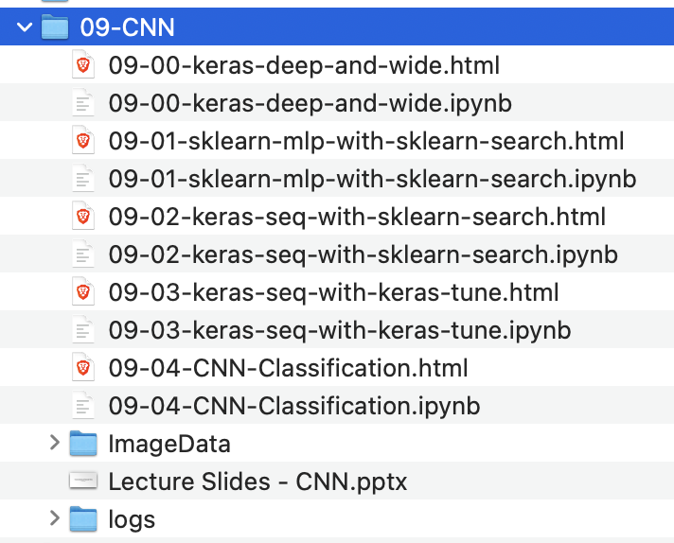
For the first part of the lecture:
Download the files from the following link…
https://usf.box.com/s/7bn9cox3sqyyw32lqqps2cb4nmcq0buv

Slide 4
Convolutional Neural Networks
"Discrete convolution": a mathematical operation on two functions (f and g) to produce a third function that expresses how the shape of one is modified by the other (Wikipedia)
Input data: images (usually)
Used in
Image search
Image classification
Self-driving cars

Slide 5
Review on Images
If black and white, there is 1 channel
If color, there are 3 channels: Red, Green, Blue (RGB)
B&W
RGB

Slide 6
Image Data
Image size is measured in pixels.
Ex: 480 x 480 means:
480
480
B&W
RGB
Size = 480 x 480 x 1
Size = 480 x 480 x 3

Slide 7
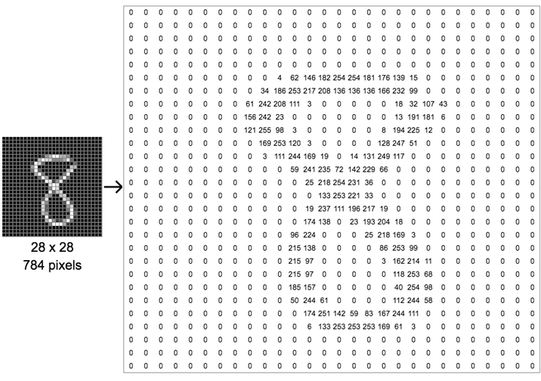
Image Data
Each pixel has a value between 0-255

Slide 8

Image Data
Let's think of a 1M (megapixel) image
1 megapixel = 1,000,000 pixels (1,000 x 1,000)
Resize
1,000
100
100
1,000
10,000 pixels
10K image

Slide 9
Image Data
Problem???
10 million connections in the first layer alone!
………………
100
100
Input layer = 10,000 nodes
Layer 1 =
1,000 nodes

Slide 10
Solution:
STEP 1 (convolution): Extract features from an image:
Horizontal lines,
Vertical lines,
Curvature,
Colors,
Etc.
STEP 2 (pooling): Reduce the variables (without losing information)
GET HELP FROM HUMAN VISUAL CORTEX

Slide 11
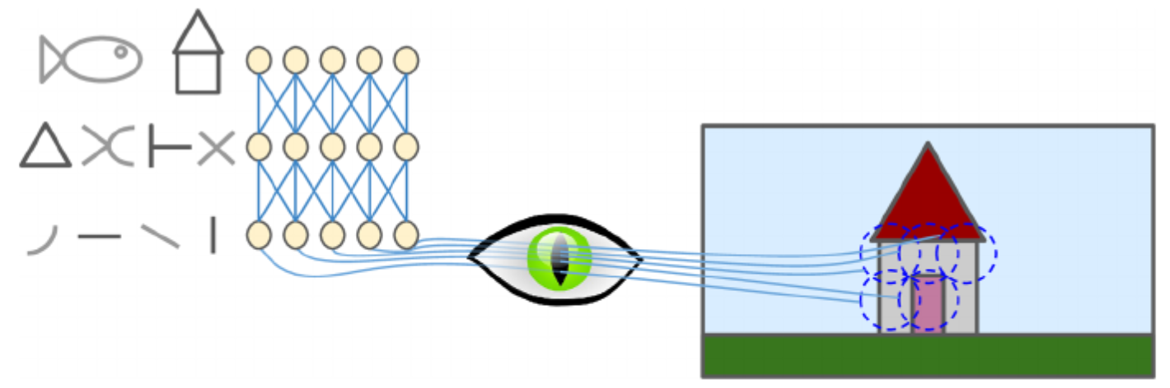
Convolutional Neural Networks
The visual cortex is made up of neurons
Each neuron has a specific receptive field (and do not necessarily see the things outside of that field)
Receptive field of a neuron

Slide 12
Convolutional Neural Networks
Further, some neurons react only to horizontal lines
Some react to different orientations
Higher level neurons make sense of the pattern detected at lower levels

Slide 13
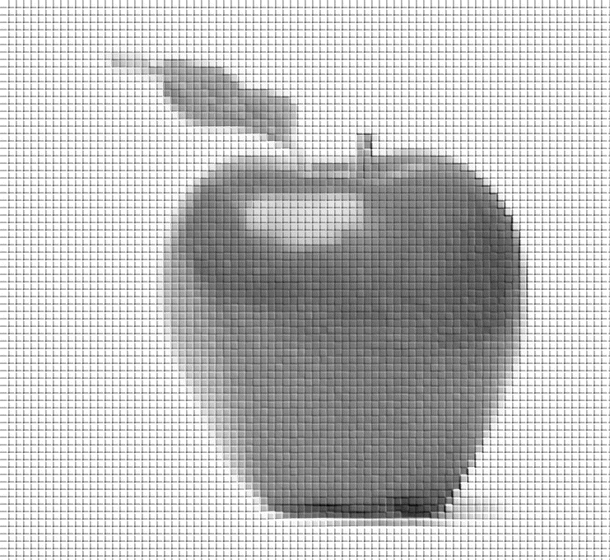
Convolutional Layer
Grayscale (1 channel)
Apply the same logic:
Feature Map 1
“Receptive field”
Also called:
“Filter”
“Kernel”
Extract vertical features using a vertical filter

Slide 14
Convolutional Layer
Grayscale (1 channel)
Apply the same logic:
Feature Map 2
“Receptive field”
Also called:
“Filter”
“Kernel”
Extract horizontal features using a horizontal filter

Slide 15
Convolutional Layer
Feature Map 1
Feature Map 2
Feature Map n
Conv Layer 1

Slide 16
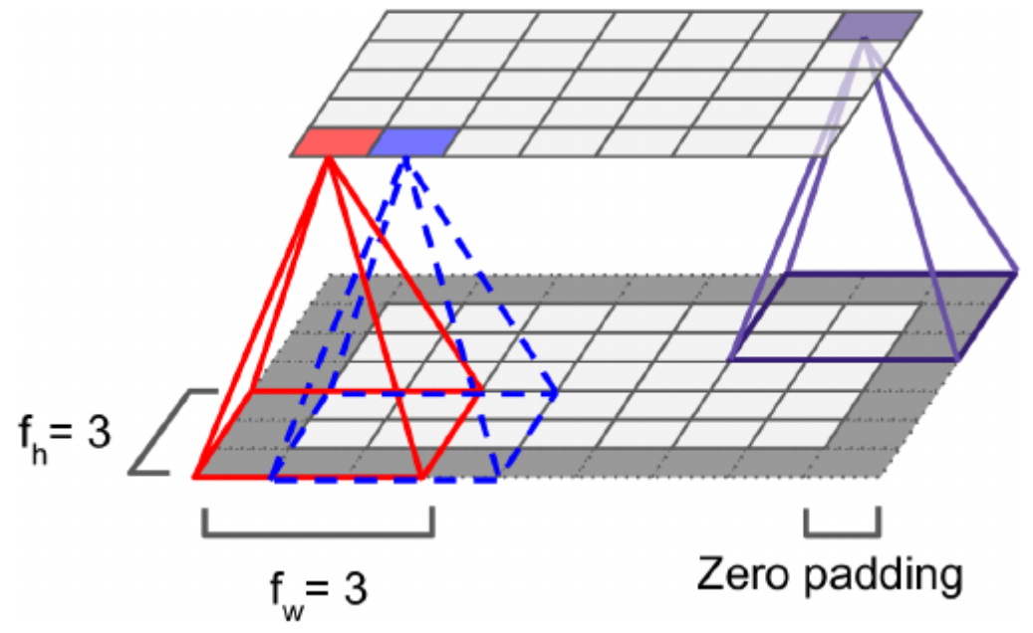
Convolutional Layer
Stride = 1
Makes the size of second layer the same as first

Slide 17
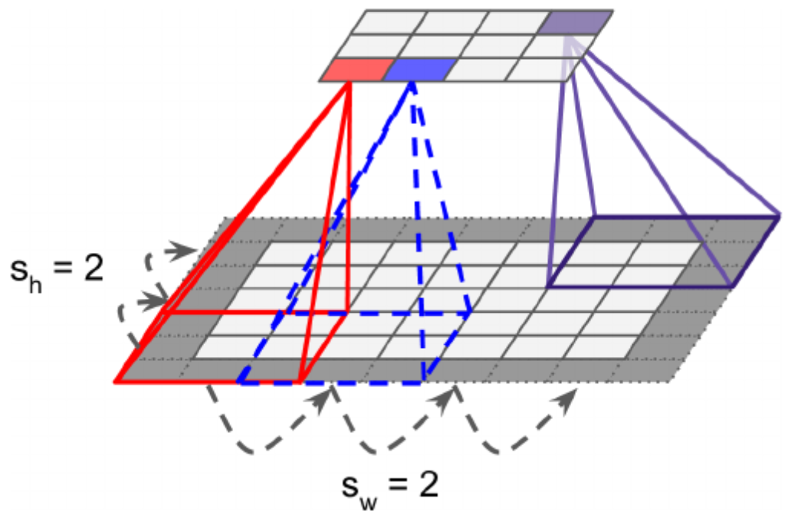
Convolutional Layer
You can have varying strides (both horizontally, and vertically)
Notice the size got smaller even with zero padding

Slide 18
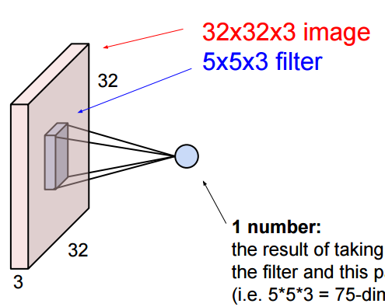
Convolutional Layer
If you have RGB (3-channel) image, the filter has 3 channels too

Slide 20
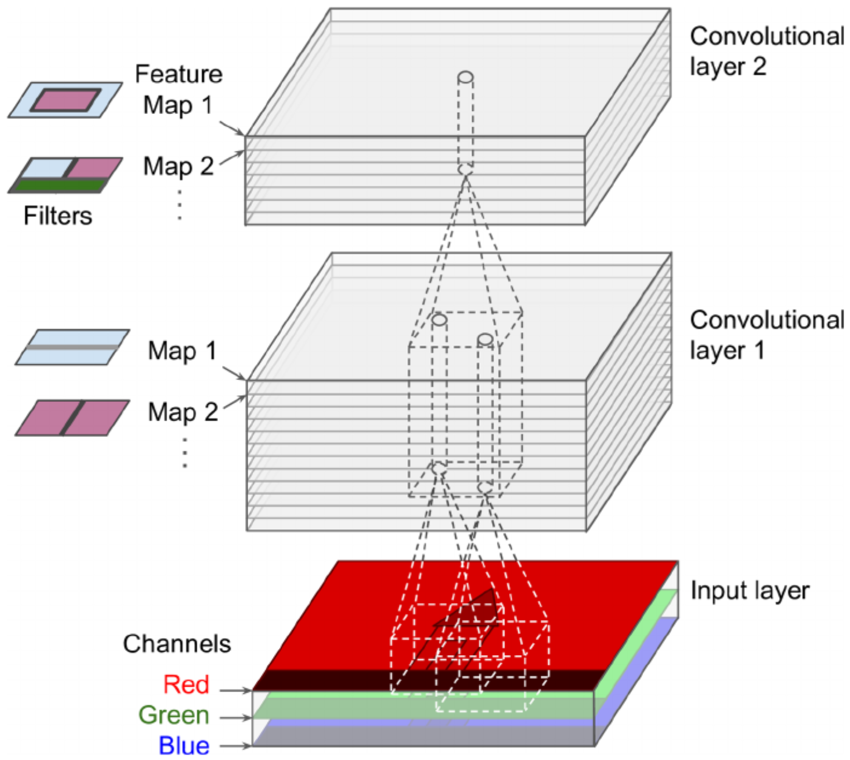
Convolutional Layer
Eventually, you have multiple feature maps (per convolutional layer)

Slide 21
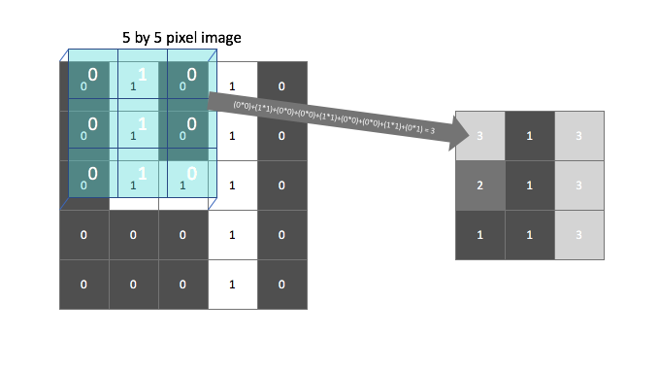
Convolutional Layer
How to process the values inside the “filter”
Multiply them with “weights” then add them up
Example: Apply “vertical” filter (to highlight vertical lines)
(Actually, this sum is passed through an activation function (ReLU) to introduce non-linearity
5 x 5 image
3 x 3 filter
0 | 1 | 0 | 1 | 0
0 | 1 | 0 | 1 | 0
0 | 1 | 1 | 1 | 0
0 | 0 | 0 | 1 | 0
0 | 0 | 0 | 1 | 0
0 | 1 | 0
0 | 1 | 0
0 | 1 | 0
Output is called “feature map”

Slide 22
Convolutional Layer
Then, apply “horizontal” filter (to highlight horizontal lines)
There are many more filters…
5 x 5 image
3 x 3 filter
0 | 1 | 0 | 1 | 0
0 | 1 | 0 | 1 | 0
0 | 1 | 1 | 1 | 0
0 | 0 | 0 | 1 | 0
0 | 0 | 0 | 1 | 0
0 | 0 | 0
1 | 1 | 1
0 | 0 | 0

Slide 23
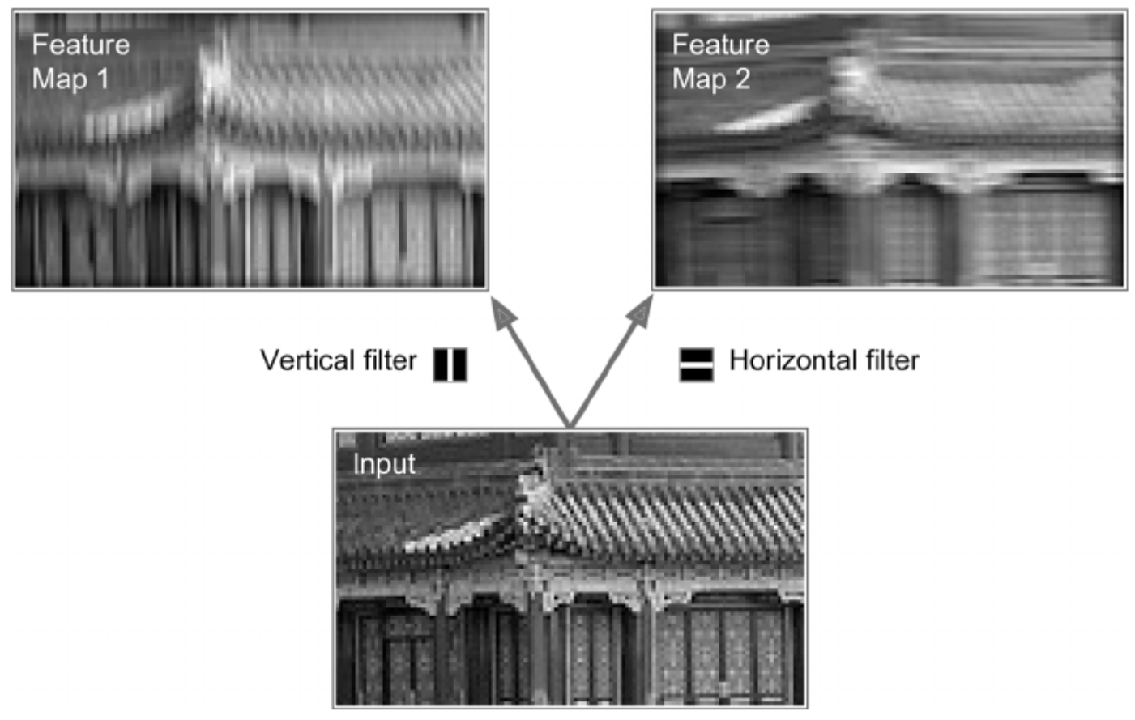
Convolutional Layer

Slide 24
Memory Requirements
Imagine a single image with 150 x 100 pixels
Filter of 5 x 5 with 1 stride
200 feature maps
Padding (add when necessary)
Calculations:
( 5 x 5 x 3 + 1 ) x 200 = 15,200 terms
Each feature map has 150 x 100 neurons that need to compute 5 x 5 x 3 inputs. Makes 225 million multiplications
1 image needs 12 MB RAM.
100 images 1.2 GB RAM.

Slide 25
Pooling Layer
“Shrinks” the convolutional layer (by sampling)
An “aggregation” technique!
Why:
Reduce computational load
Reduce number of parameters
Reduce overfitting

Slide 26
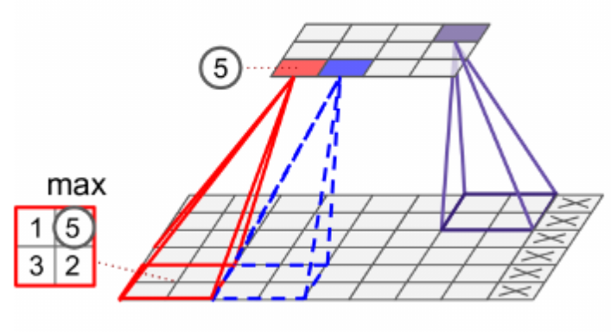
Pooling Layer
Similar to earlier: define the size, stride, padding type
It AGGREGATES the values
Example: use min, max, average, etc.
A 2 x 2 kernel with a stride of 2 reduces the image (inputs) by 75%
You can set it to shrink channels too

Slide 27
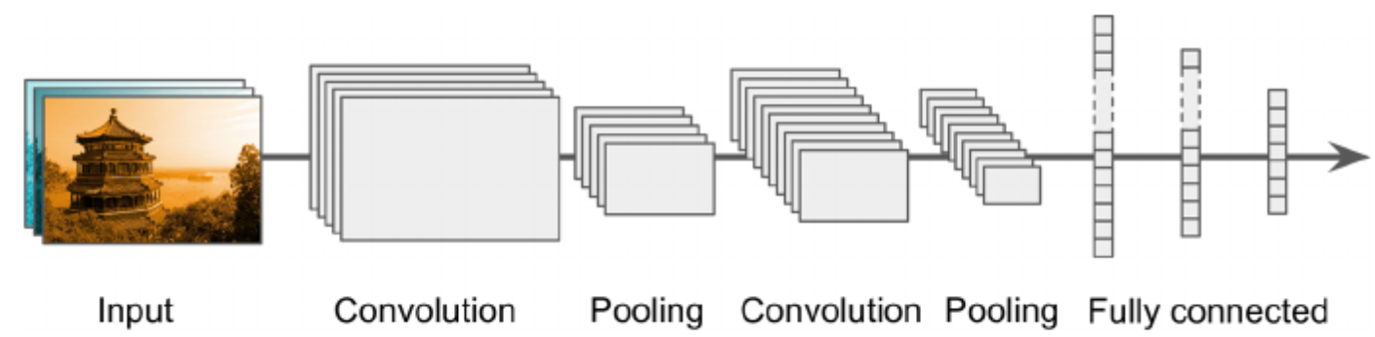
CNN Architectures
FLATTEN!!!
Based on “stacking”
Image gets smaller and smaller going through the layers
Use a regular deep neural network at the end
Regular neural network

Slide 28
CNN Architectures
Can also stack two convolutional layers one after another
Instead of having a 5 x 5 convo layer, have two 3 x 3 stacked convo layers. Might perform better!
Double the filter size as you go deeper in CNN
Regular neural network

Slide 29

LeNET-5
Developed in 1998
Used the MNIST data set (handwritten digits)
Labeled data
Black and white
28x28
60,000 images for training
10,000 images for testing

Slide 30
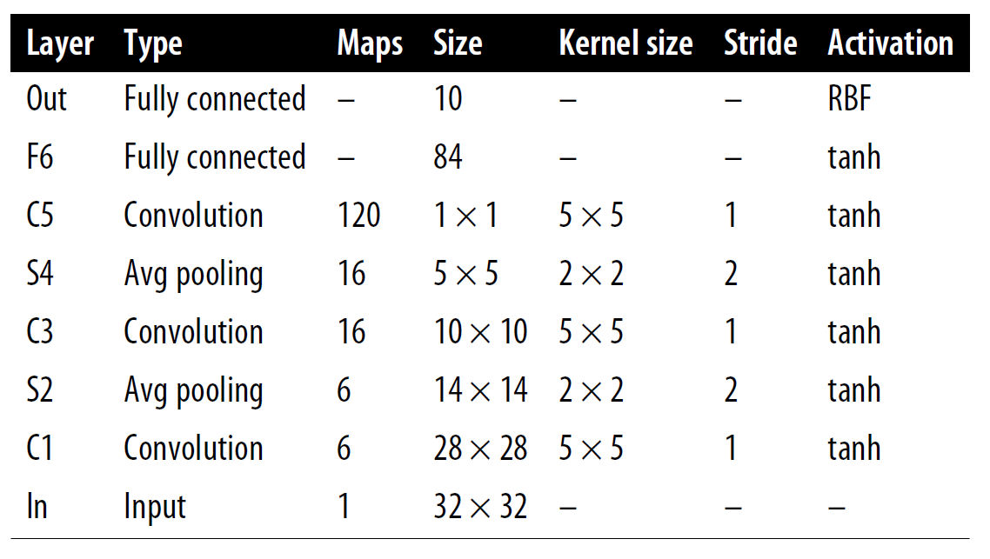
LeNET-5
Architecture:
Error: less than 1%

Slide 31
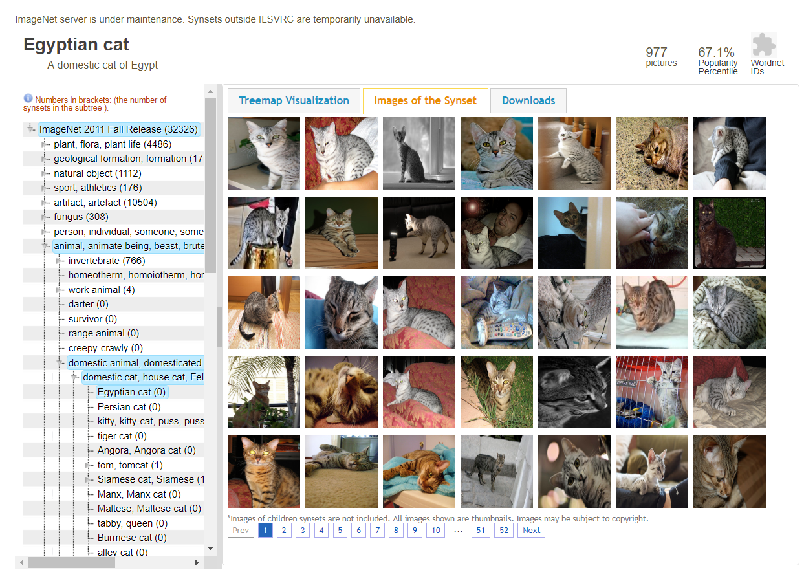
AlexNET
Developed in 2012
Achieved 17% error rate in ILSVRC imagenet challenge
Labeled data (1,000 classes)
150,000 images in total

Slide 32
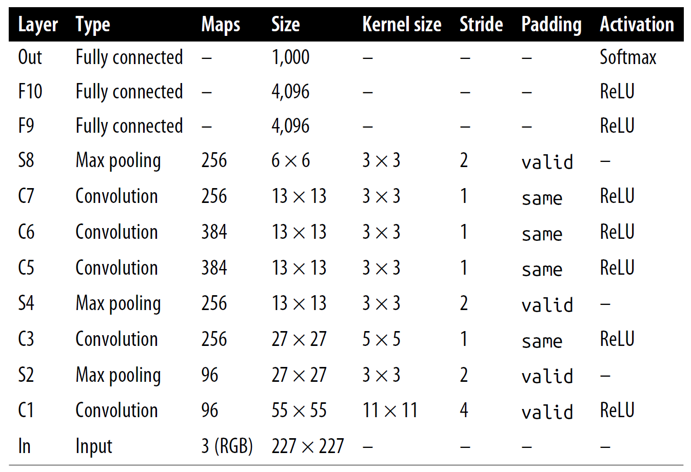
AlexNET
Architecture:
Used 50% dropout at F9 and 10
Performed data augmentation
Changed lighting conditions
Local response normalization

Slide 33
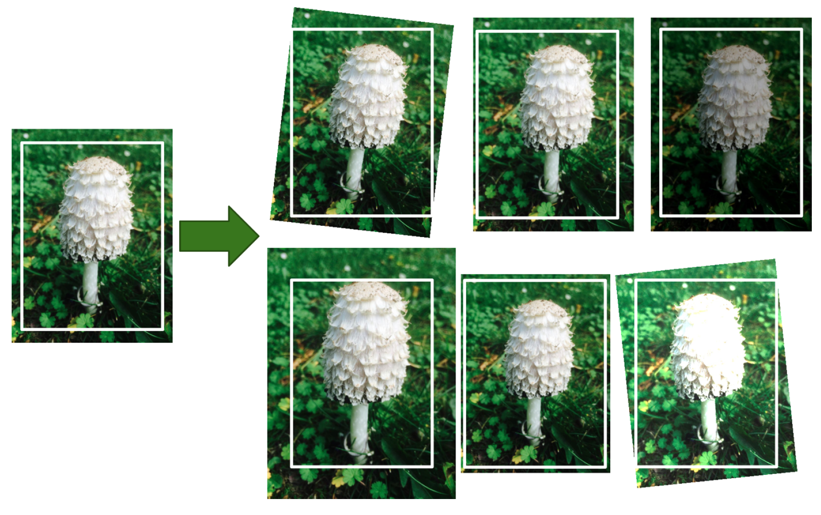
Data Augmentation
Generate new images from existing training images
Artificially increase the size
Reduces overfitting

Slide 34
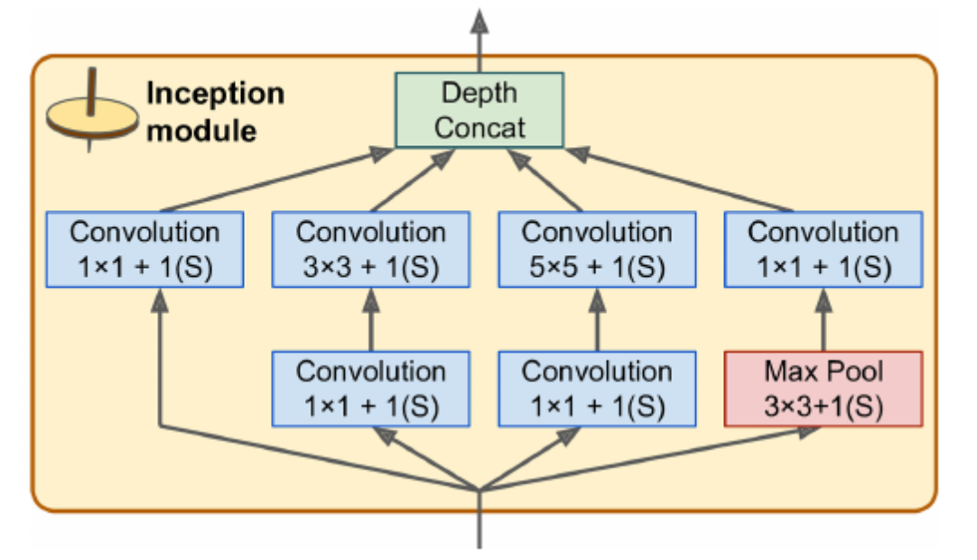
GoogLeNET
Achieved an error rate of below 7% (ILSVRC imagenet challenge)
Deeper network
Reduced AlexNET’s parameters by 10 times (from 60M to 6M)
Used sub-networks called inception
Why use 1x1 filters?
Capture patterns along depth dimension
Reduce dimensionality (bottleneck layers)

Slide 35
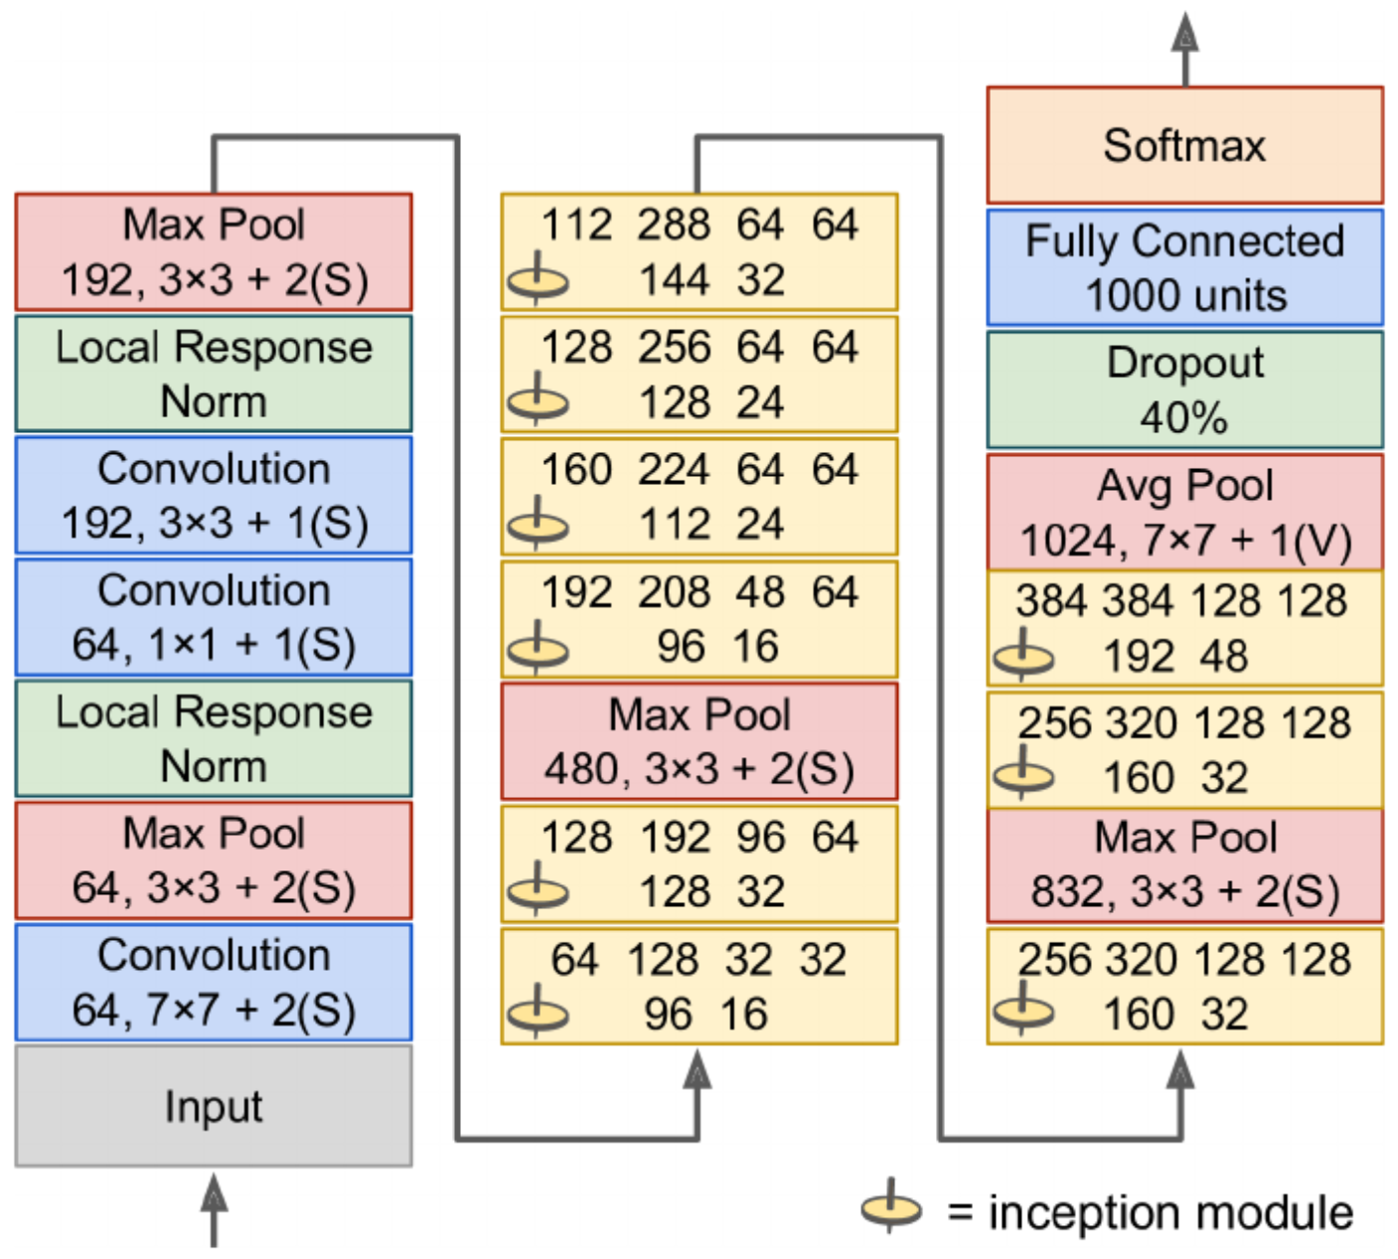
GoogLeNET

Slide 36
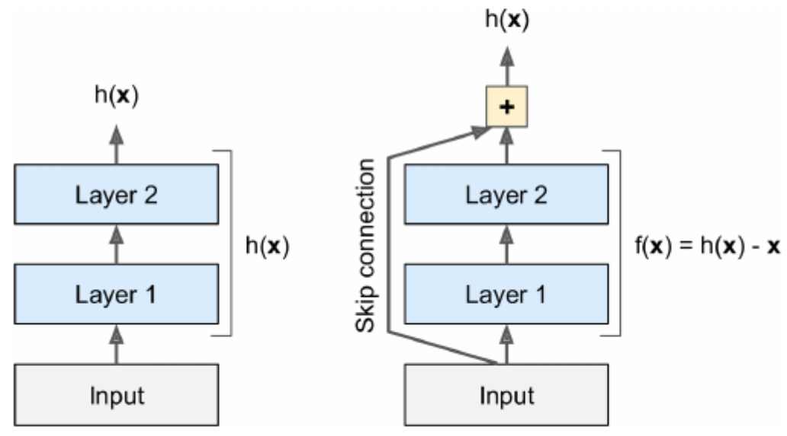
ResNET
Reduced the error rate below 3.6%
A total of 152 layers
Used skip (shortcut) connections
Helps perform residual learning
Skipping connections helps train faster

Slide 37
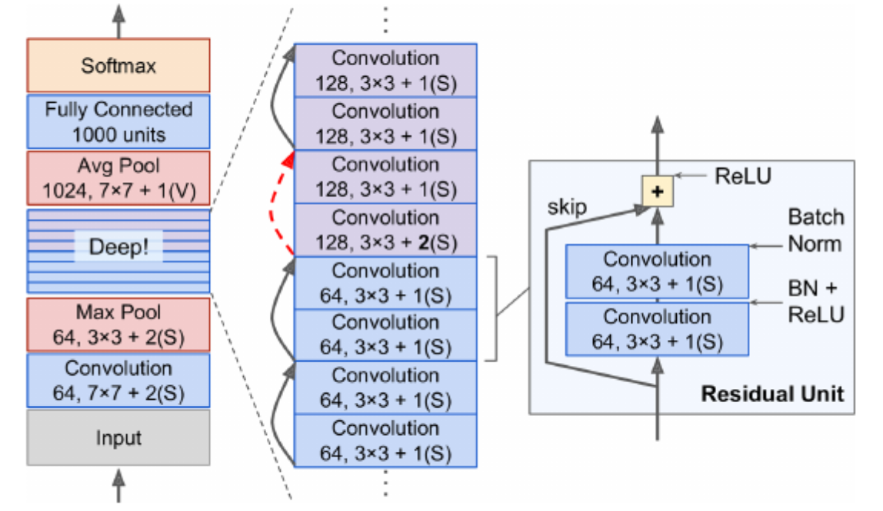
ResNET

Slide 38
Other Models
VGGNet
Xception (a variant of GoogLeNet)
SENet (reduced the error rate to 2.25% in 2017)
Inception v4
Combination of GoogLeNet and Resnet

Slide 39

Data Requirements
We need labeled images (most of the time)

Slide 40
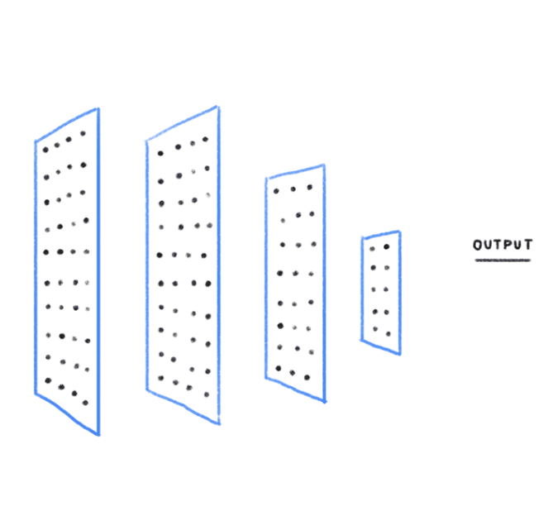
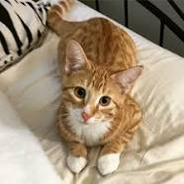
Image classification
New (unseen) image
CNN
Cat

Slide 41
Object detection
New (unseen) image
CNN
Cat 0.95

Slide 42
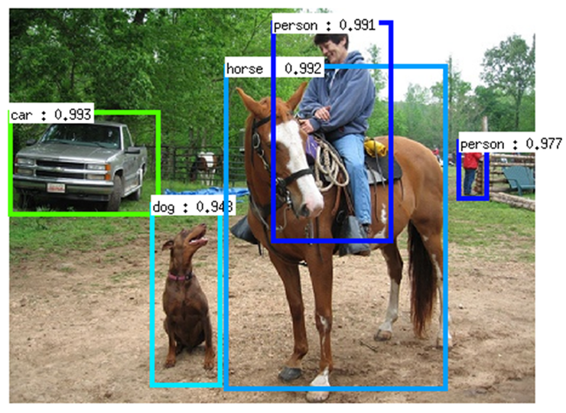
Object detection
Example
A popular model: You Only Look Once (YOLOv3)

Slide 43
Image segmentation
New (unseen) image
CNN
Cat

Slide 44
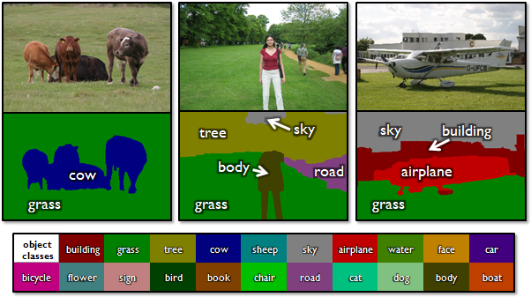
What Kind of Output Does it Generate?
Image segmentation example

Slide 45
How Are We Going to Use CNNs?
Image classification

